Slide 1
Introduction to Data

Slide 2

Content
Enterprise Data landscape blueprint
Database vs Datawarehouse vs DataLake
DataOps
Scalable Cloud Data Warehouses
Azure Synapse Architecture
Redshift Architecture
ETL tools – Introduction
ETL tools
Orchestration tools
Sample use cases/Architectures
Feedback and Questions

Slide 3
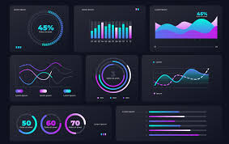
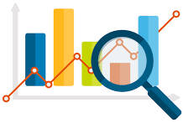
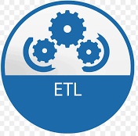

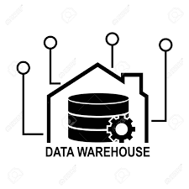
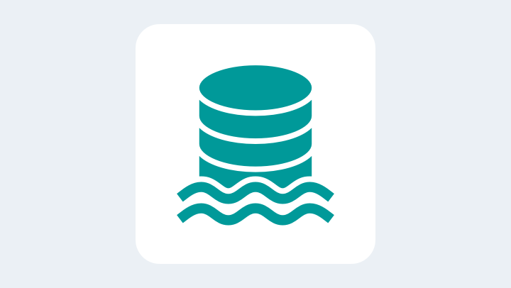
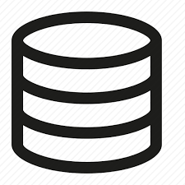
Enterprise Data landscape Blueprint
Data warehouse 1
Operational Systems
Operational
Visualization and analytics
Streaming, API and
batch data
Data Lake
Application 1
Application 2
Data science
Adhoc Analytics
Machine Learning
And many more..
Data warehouse 2

Slide 4
Database vs Data Warehouse vs Data Lake
 | Database | Data Warehouse | Data Lake
Purpose | Operational/Transactional systems | Operational Analytical systems | Adhoc Analytics, Machine learning and data science
Data | Structured | Structured | Raw and unstructured
Business Criticality/Operational severity | Very high | Very high to high | Mostly less critical(Varies)
Users | Application users | Business Users/Decision makers | Data scientists and ML Engineers Analytical teams
Security | Closely tied to the application | Rationalized based on the data consumer | Widely available
Schema Flexibility | Rigid | Pre-defined and modelled | Schema on read
Post processing Complexity | Less complex | Prepared data – Less complex | Complex based on the use case
History data | As per application requirement | Historic and current data – Data retention is subjective | Historic and current data – Data retention is subjective

Slide 5
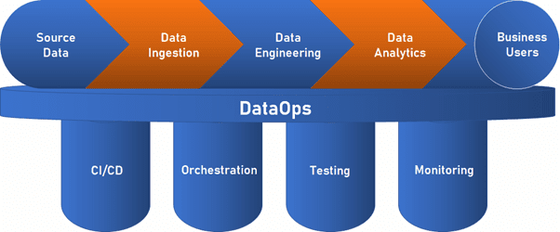
Data Ops
DataOps is an enterprise strategy which is primarily focused on
Reducing the elapsed time between proposal of new idea and finished analytical pipeline
Measured by the number of analytical products productionized in a given period of time
DevOps and Data operations are part of DataOps
More on DataOps
https://datakitchen.io/what-is-dataops/

Slide 6
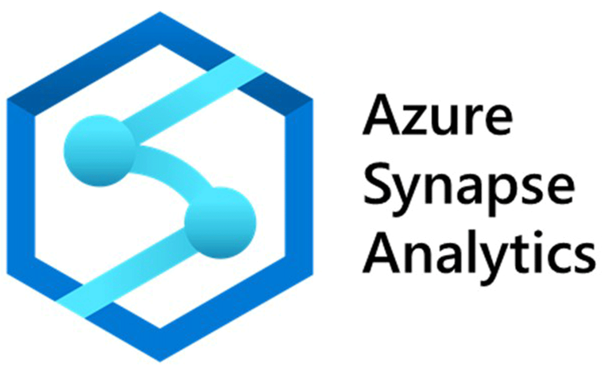


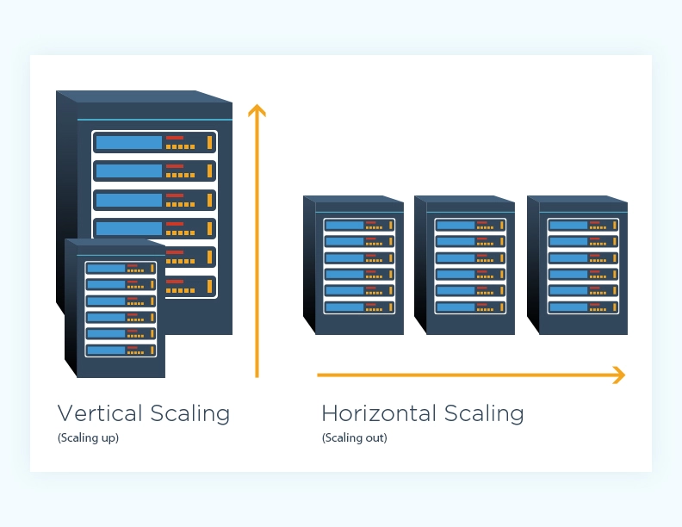

Scalable Cloud Data Warehouses
With the power of cloud and limitless infrastructure, data warehouses have become intelligent and scalable based on the workloads
Scale horizontally based on query workloads
Support MPP for parallel processing
Support SQL based query engines
Variety of connections and compatibilities to Reporting and ETL tools
Abstract data and underlying infrastructure management to enable quick insights and data driven decision making
Columnar oriented databases which support OLAP – Read heavy use cases.(Row based architectures are good for OLTP. Transactional systems)
Fault tolerant with replication and disaster recovery options
Customizable concurrency and scaling features for effective cost and performance management
Uses compression for the storage of data, so that the storage costs are optimized

Slide 7
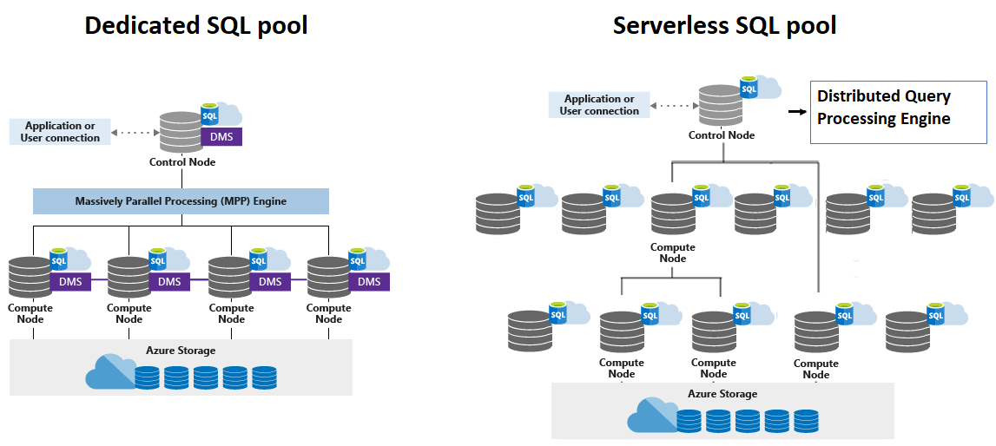
Azure Synapse – Architecture

Slide 8
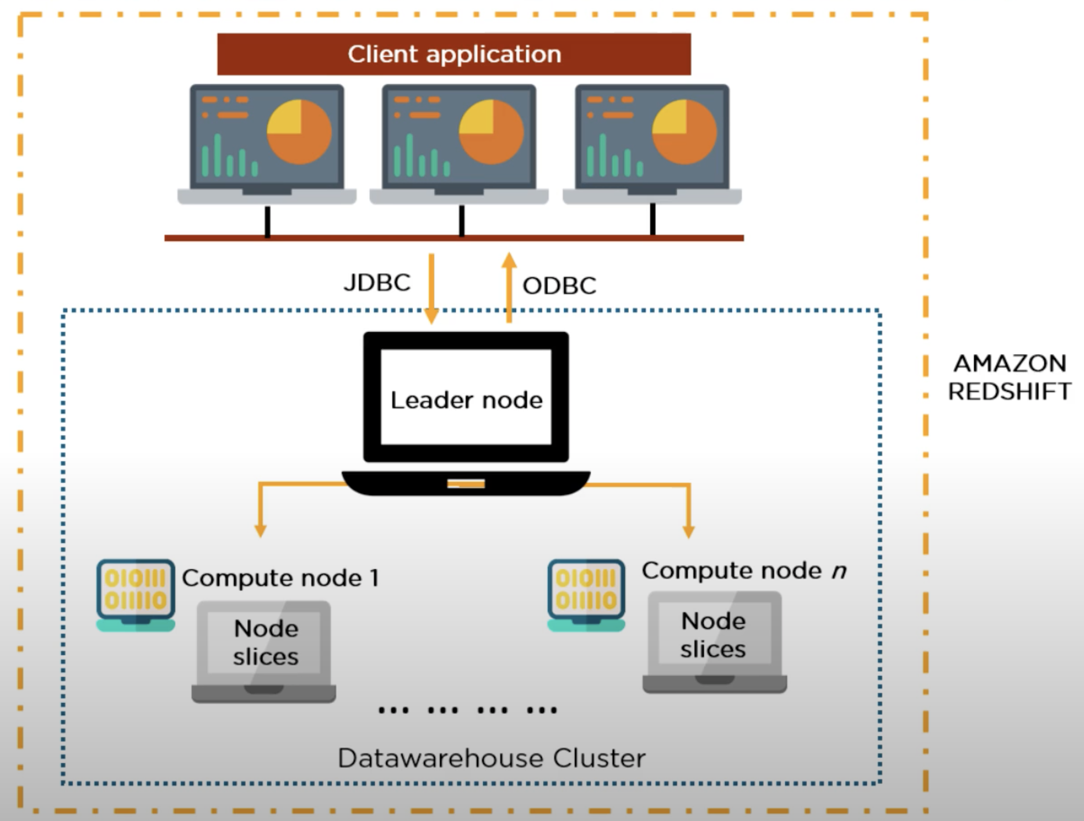
Redshift – Architecture
Sources of batch data:
Copy from S3
Copy from EMR
Copy from remote Host(SSH)
Copy from DynamoDB
Sources of Streaming data:
Amazon Kinesis firehose can directly add redshift as a destination

Slide 9
ETL – Tools Introduction
Extract transform and load(ETL) tools are used to move the data from one place to another while transforming them in-flight
Three common usages as below
Transform and ingest to Datawarehouse
Transform within Datawarehouse
Extract and transform from Datawarehouse
Consuming Applications
Data Sources

Slide 10
Glue and Other tools
AWS
Glue
Kinesis
Data pipeline
Azure
Azure Data Factory
Azure Synapse pipelines
GCP
Cloud Data Fusion
DataFlow
Dataproc
Outside Cloud
Ab-Initio
Talend
Informatica
Stitch
And many more…

Slide 11



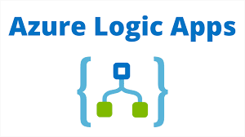
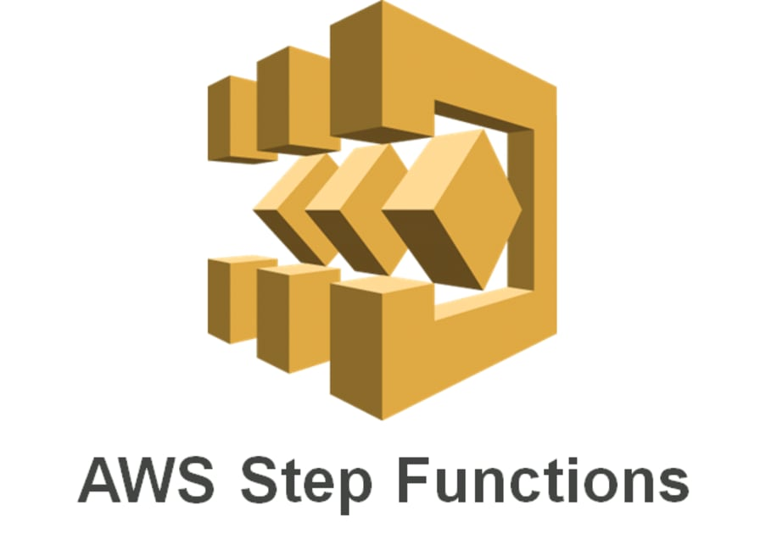



Orchestration Tools

Slide 12
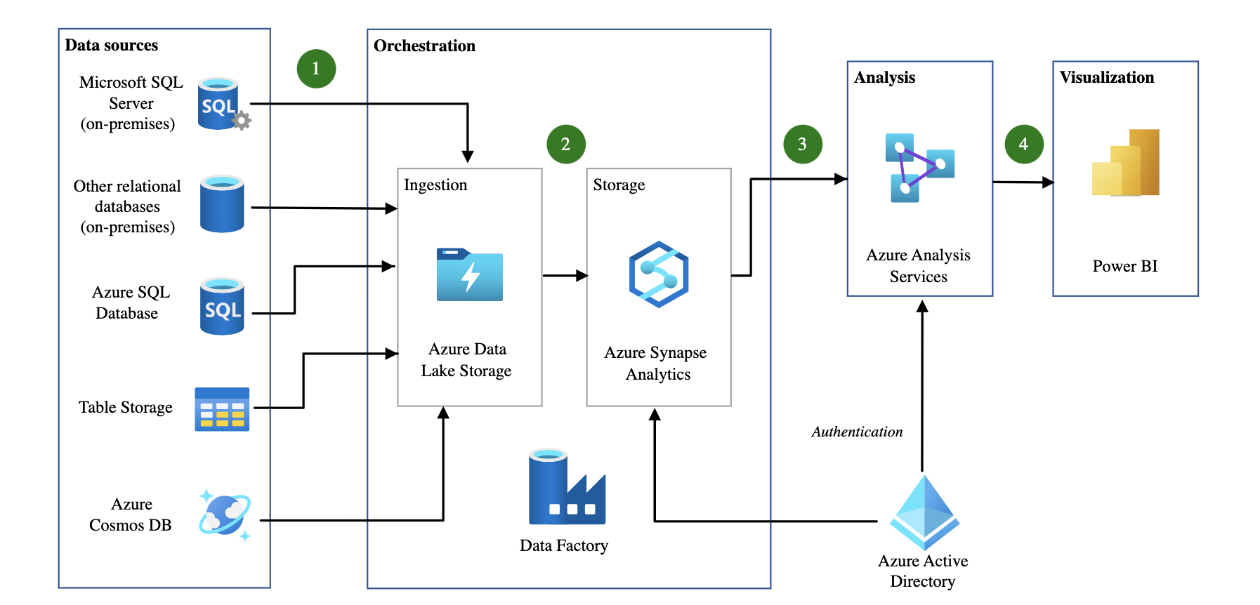
Sample Architecture 1
https://learn.microsoft.com/en-us/azure/architecture/example-scenario/data/data-warehouse

Slide 13
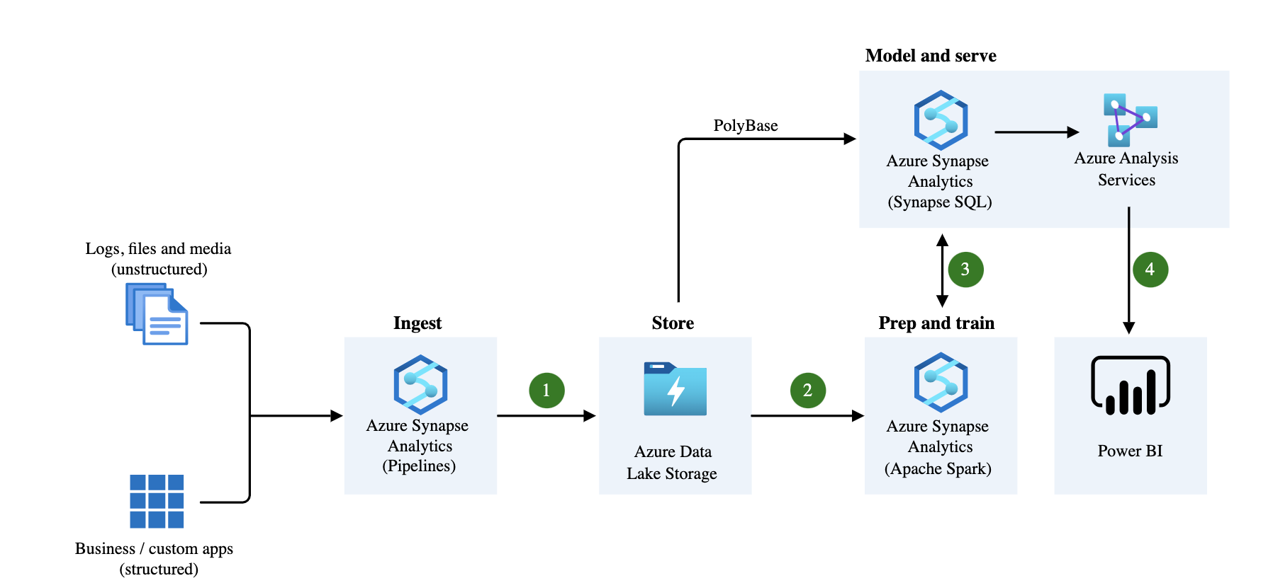
Sample Architecture 2
https://learn.microsoft.com/en-us/azure/architecture/solution-ideas/articles/enterprise-data-warehouse

Slide 14
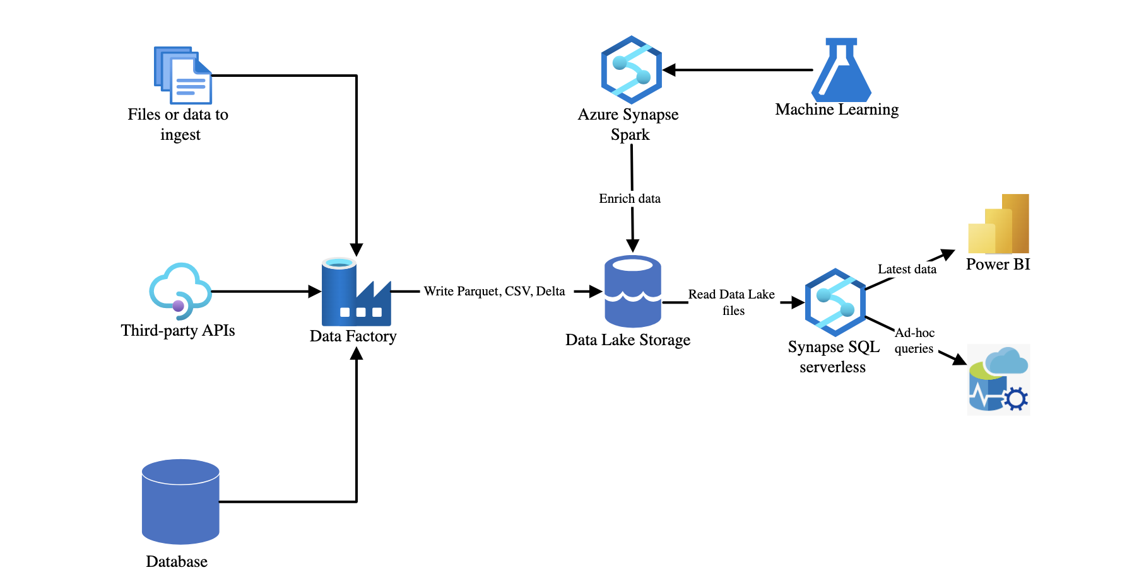
Sample Architecture 3 – Data lake
https://learn.microsoft.com/en-us/azure/architecture/browse/?terms=data%20lake

Slide 15
OLTP vs OLAP – Generic differences
 | OLTP | OLAP
Nature of workload | OLTP systems are designed to handle transactional workloads, such as recording and processing day-to-day business transactions | OLAP systems are used for analytical processing and complex data analysis.
Design optimization purpose | They are optimized for fast and efficient data input, retrieval, and modification. | They are designed to handle large volumes of data and support complex queries, aggregations, and data mining operations.
Example systems | Examples of OLTP applications include banking systems, e-commerce websites, airline reservation systems, and point-of-sale systems. | Examples of OLAP applications include business intelligence tools, data warehouses, and reporting systems.

Slide 16
OLTP vs OLAP – Data design differences
 | OLTP | OLAP
Data model methodology | OLTP databases typically have a normalized data structure, meaning data is organized into separate tables to minimize redundancy and ensure data integrity. | OLAP databases often have a denormalized or star schema data structure, where data is pre-aggregated and organized into a dimensional model for easier analysis.
Indexing | OLTP databases typically use indexes on specific columns to optimize transactional operations, such as searching and updating records. Indexes are essential for efficient data retrieval and maintaining data consistency in OLTP systems. | In OLAP databases, indexing strategies may vary based on the specific analytical requirements. While indexes can still be used in OLAP systems, they are not as crucial as in OLTP systems. OLAP systems often rely on other optimization techniques like pre-aggregation, partitioning, or compression to improve query performance.
Data Volume | OLTP databases generally handle moderate to high volumes of data due to the continuous recording and processing of business transactions. However, the emphasis is on processing individual transactions efficiently rather than storing large amounts of historical data. | In contrast, OLAP databases typically store and process large volumes of historical data for analytical purposes. These systems are optimized to handle complex queries across extensive datasets, including aggregations, slicing, dicing, and multidimensional analysis.
Data Latency | OLTP systems prioritize real-time processing and aim to minimize data latency. Changes made to the database need to be immediately reflected to ensure data consistency and transactional integrity. | OLAP systems focus on analysing and reporting on historical data, and they usually have a higher tolerance for latency. Data in OLAP systems is typically updated periodically, such as on a daily, weekly, or monthly basis, depending on the organization's needs.

Slide 17
Row Vs columnar storage
Row Storage | Columnar Storage
In row-based storage, data is stored and retrieved by rows. Each row contains a complete record with all its attributes or fields. Row-based storage is well-suited for OLTP (Online Transaction Processing) systems, where individual transactions and records need to be accessed and modified quickly. It is efficient for transactional operations that involve inserting, updating, or deleting a small number of records. Row-based storage is optimized for write-intensive workloads, as it allows for fast record updates and maintains data integrity by minimizing data duplication. However, it can be less efficient for analytical queries that involve aggregations or accessing a subset of columns. | In columnar storage, data is stored and retrieved by columns or attributes. Each column contains the values for a specific attribute across all records. Columnar storage is well-suited for OLAP (Online Analytical Processing) systems, where complex analytical queries and aggregations are performed on large volumes of data. It is optimized for read-intensive workloads, as columnar storage allows for efficient data compression, reduced I/O operations, and improved query performance. Columnar storage is particularly useful for data analysis scenarios that involve accessing a subset of columns or performing aggregations on specific attributes. However, columnar storage can be less efficient for write operations, as updating or inserting new records requires modifying multiple column segments.
https://www.geeksforgeeks.org/what-is-a-columnar-database/

